Slide 1
Azure Active Directory
Speaker name
Speaker Title
twitter-handle or website

Slide 2
Agenda
What is Azure Active Directory
Azure AD and Developers
Visual Studio 2015 and Azure AD
Resources

Slide 3
What is Azure Active Directory?
A comprehensive identity and access management cloud solution.
It combines directory services, advanced identity governance, application access management and a rich standards-based platform for developers
It is available in 3 editions: free, Basic and Premium

Slide 4
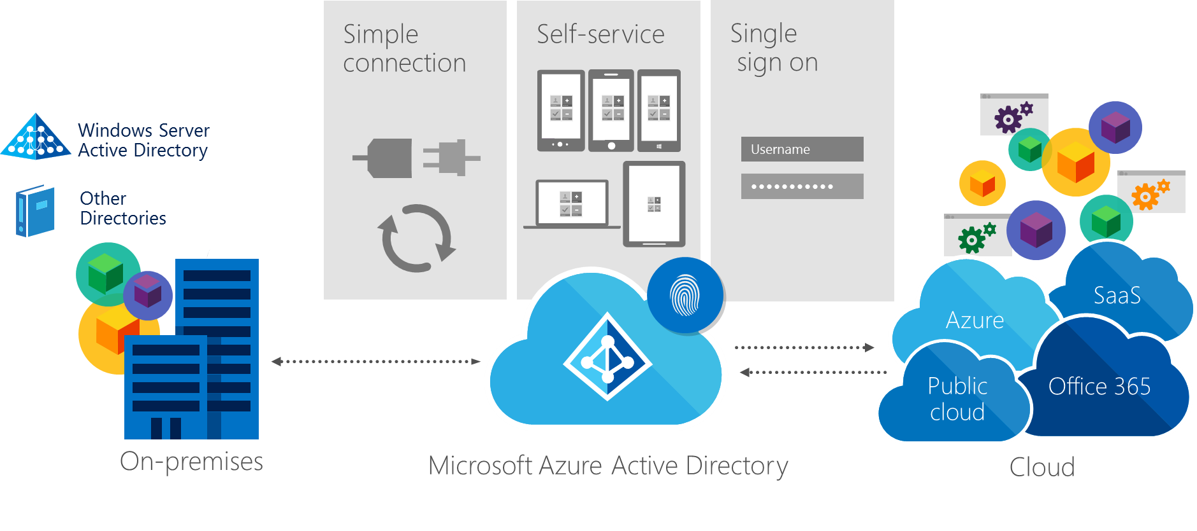
Identity as the control plane

Slide 5
Azure Active Directory editions feature comparison + Office 365 IAM features
 |  | Azure AD Free | Azure AD Basic | Azure AD Premium | Office 365 IAM features
Common Features | Directory as a Service | 500,000 Object Limit | No Object Limit | No Object Limit | No Object limit for Office 365 user accounts
 | User/Group Management (add/update/delete) | Yes | Yes | Yes | Yes
 | SSO to pre-integrated SAAS Applications /Custom Apps | 10 apps per user | 10 apps per user | No Limit | 10 apps per user
 | User-Based access management/provisioning | Yes | Yes | Yes | Yes
 | Self-Service Password Change for cloud users | Yes | Yes | Yes | Yes
 | Identity Synchronization Tool (Windows Server AD integration, Multi Forest) | Yes | Yes | Yes | Yes
 | Security Reports | 3 Basic Reports | 3 Basic Reports | Advanced Security Reports | 3 Basic Reports
 | Cloud App Discovery* | Yes(Basic) | Yes(Basic) | Yes(Advanced)** | Yes(Basic)
Premium+ Basic Features | Group-based access management/provisioning |  | Yes | Yes
 | Self-Service Password Reset for cloud users |  | Yes | Yes
 | Company Branding (Logon Pages/Access Panel customization) |  | Yes | Yes
 | SLA |  | Yes | Yes | Yes
Premium Features | Identity Synchronization Tool advanced write-back capabilities * (FY15 Roadmap) |  |  | Yes
 | Self-Service Group Management |  |  | Yes
 | Self-Service Password Reset/Change with on-premises write-back |  |  | Yes
 | Advanced Usage Reporting |  |  | Yes
 | Multi-Factor Authentication (Cloud and On-premises (MFA Server)) |  |  | Yes | Limited Cloud only features for accessing Office 365
 | Azure AD Application proxy* |  |  | Yes
 | MIM CAL + MIM Server |  |  | Yes
 | Administrative Delegation* (FY15 Roadmap) |  |  | Yes
*Features in Preview (Sept 2014) or in the roadmap
** Advanced functionality on Cloud App Discovery is in the roadmap for FY15 H2
10 Apps per user : Every user can have a different set of Apps, up to ten. MS Online apps (e.g. O365) are counted among these 10.

Slide 6
Enterprise Grade, at Cloud Scale
Every time you sign in with Office 365 or Azure, you are using Azure AD

Slide 7
Enterprise Grade, at Cloud Scale
Probably the largest enterprise identity and access solution on the planet

Slide 8
Enterprise Grade, at Cloud Scale
Probably the largest enterprise identity and access solution on the planet
18 Billion authentications
in a single week!

Slide 9
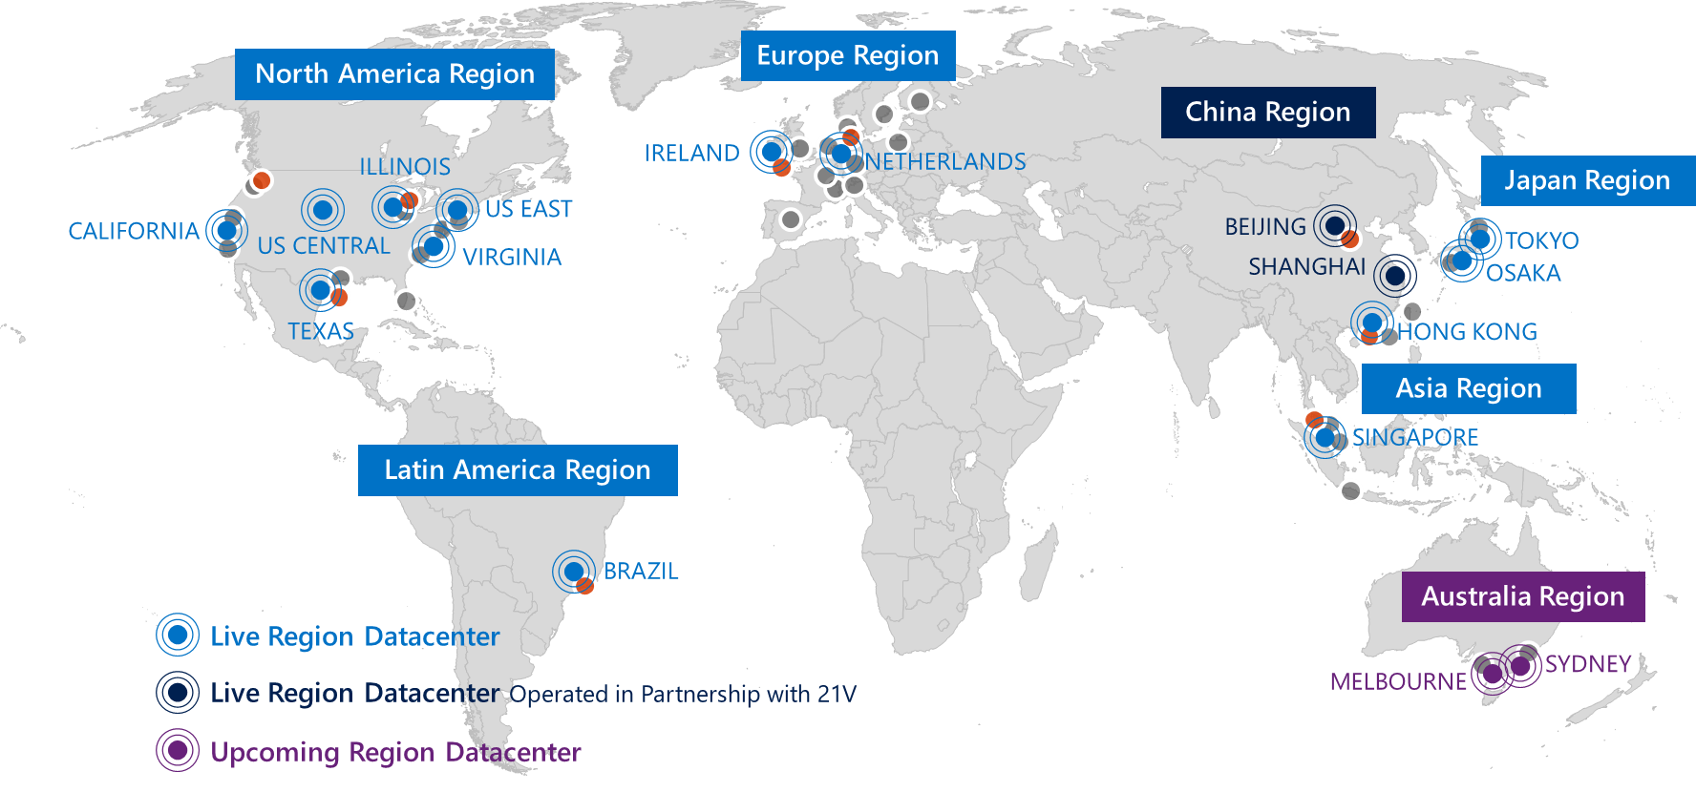
Enterprise Grade, at Cloud Scale
99.9% SLA
3x redundancy across datacenters throughout the world

Slide 10

Use Azure AD in Your Own Apps

Slide 11
Use Azure AD in Your Own Apps

Slide 12
Use Azure AD in Your Own Apps

Slide 13



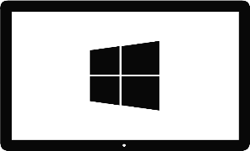


Platforms, Form Factors, Protocols
Azure Active Directory
OAuth2 &
OpenID Connect
SAML
WS-Federation
REST based Graph API

Slide 14
Demo

Slide 15
Resources
azure.com/aad
github.com/AzureAD
github.com/AzureADSamples

